Slide 1
Chapter 5-4
Tying It All Together
计算机系统概论
Introduction to Computing Systems
（CS1002A.01）
苗付友
mfy@ustc.edu.cn
2025 Fall
计算机科学与技术学院
School of Computer Science and Technology

Slide 2
Outline
1
1
Review
Review
2
An Example: Counting Occurrences of a Character
2
From ENIAC to the Stored Program Computer
3
3
A Machine Structure：von Neumann Model
ISA & Data Path Revisited
4
4
Summary
Summary

Slide 3
Outline
1
1
Review
Review
2
An Example: Counting Occurrences of a Character
2
From ENIAC to the Stored Program Computer
3
3
A Machine Structure：von Neumann Model
ISA & Data Path Revisited
4
4
Summary
Summary

Slide 4
Control Instructions
15
14
13
12
11
10
9
8
7
6
5
4
3
2
1
0
BR
0
0
0
0
n
z
p
PCoffset9
JSR
0
1
0
0
1
PCoffset11
JSRR
0
1
0
0
0
0
0
BaseR
0
0
0
0
0
0
RTI
1
0
0
0
0
0
0
0
0
0
0
0
0
0
0
0
JMP
1
1
0
0
0
0
0
BaseR
0
0
0
0
0
0
RET
1
1
0
0
0
0
0
1
1
1
0
0
0
0
0
0
TRAP
1
1
1
1
0
0
0
0
TrapVector8

Slide 5
Condition Codes
LC-3 has three condition code registers:
N -- negative
Z -- zero
P -- positive (greater than zero)
Set by any instruction that writes a value to a register
(ADD, AND, NOT, LD, LDR, LDI, LEA)
Exactly one will be set at all times
  Based on the last instruction that altered a register

Slide 6
Outline
1
1
Review
Review
2
An Example: Counting Occurrences of a Character
2
From ENIAC to the Stored Program Computer
3
3
A Machine Structure：von Neumann Model
ISA & Data Path Revisited
4
4
Summary
Summary

Slide 7
Counting the occurrences of a character in a file
Program begins at location x3000
Read character from keyboard
Load each character from a “file”
  File is a sequence of memory locations
  Starting address of file is stored in the memory location
  immediately after the program
If file character equals input character, increment counter
End of file is indicated by a special ASCII value: EOT (x04)
At the end, print the number of characters and halt
(assume there will be less than 10 occurrences of the character)

Slide 8
Counting the occurrences of a character in a file
A special character used to indicate the end of a sequence
is often called a sentinel.
  Useful when you don’t know ahead of time how many times
  to execute a loop.
Memory
_{x3000}
_{x3001}
_{x3002}
_{Program}
_{x3012}
_{x9000}
_{x3013}
_{ASCII x30}
_{x9000}
_{x9001}
_{Data}
_{EOT=x04}

Slide 9
Register and Memory
Memory
Register
R0: hold the character that is being counted （typed from keyboard）
R1: hold, in turn, each character that we get from the file being examined
R2: keep track of the number of occurrences
R3: pointer to file, at first, M[x3012]=x9000
R4: temp, checking R4= R1-ASCII(EOT)
Register File
R0
Input Char
_{x3000}
R1
M[R3]
_{x3001}
R2
count
_{x3002}
R3
x9000
R4
temp
R5
R6
_{Program}
R7
PC
_{x3012}
_{x9000}
x3000
_{x3013}
_{ASCII x30}
_{x9000}
_{x9001}
_{Data}
R3
_{EOT=x04}

Slide 10
Flow Chart
_{R0 =}

Slide 11
Program (1 of 2)
Address | Instruction | Comments
x3000 | 0 1 0 1 0 1 0 0 1 0 1 0 0 0 0 0 | R2 ← 0 (counter) AND R2,R2, #0
x3001 | 0 0 1 0 0 1 1 0 0 0 0 1 0 0 0 0 | R3 ← M[x3012] (ptr) LD R3, x3012 (LD R3, PTR)
X3002 | 1 1 1 1 0 0 0 0 0 0 1 0 0 0 1 1 | Input to R0 (TRAP x23) TRAP x23 (GETC)
X3003 | 0 1 1 0 0 0 1 0 1 1 0 0 0 0 0 0 | R1 ← M[R3] LDR R1, R3, #0
X3004 | 0 0 0 1 1 0 0 0 0 1 1 1 1 1 0 0 | R4 ← R1 – 4 (EOT) ADD R4,R1, #-4
X3005 | 0 0 0 0 0 1 0 0 0 0 0 0 1 0 0 0 | If Z, goto x300E BRz x300E (BRz OUTPUT)
X3006 | 1 0 0 1 0 0 1 0 0 1 1 1 1 1 1 1 | R1 ← NOT R1 NOT R1,R1
X3007 | 0 0 0 1 0 0 1 0 0 1 1 0 0 0 0 1 | R1 ← R1 + 1 ADD R1,R1,#1 -R1
X3008 | 0 0 0 1 0 0 1 0 0 1 0 0 0 0 0 0 | R1 ← R1 + R0 ADD R1,R1,R0 R0-R1
X3009 | 0 0 0 0 1 0 1 0 0 0 0 0 0 0 0 1 | If N or P, goto x300B BRnp x300B (BRnp GETCHAR)

Slide 12
Program (2 of 2)
Address | Instruction | Comments
x300A | 0 0 0 1 0 1 0 0 1 0 1 0 0 0 0 1 | R2 ← R2 + 1 ADD R2,R2,#1
x300B | 0 0 0 1 0 1 1 0 1 1 1 0 0 0 0 1 | R3 ← R3 + 1 ADD R3,R3,#1
x300C | 0 1 1 0 0 0 1 0 1 1 0 0 0 0 0 0 | R1 ← M[R3] LDR R1,R3,#0
x300D | 0 0 0 0 1 1 1 1 1 1 1 1 0 1 1 0 | Goto x3004 BRnzp x3004 (BRnzp TEST)
x300E | 0 0 1 0 0 0 0 0 0 0 0 0 0 1 0 0 | R0 ← M[x3013] LD R0,x3013 ( LD R0, ASCII)
x300F | 0 0 0 1 0 0 0 0 0 0 0 0 0 0 1 0 | R0 ← R0 + R2 ADD R0,R0,R2
x3010 | 1 1 1 1 0 0 0 0 0 0 1 0 0 0 0 1 | Print R0 TRAP x21 (OUT)
x3011 | 1 1 1 1 0 0 0 0 0 0 1 0 0 1 0 1 | HALT TRAP x25 (HALT)
X3012 | 1 0 0 1 0 0 0 0 0 0 0 0 0 0 0 0 | Starting Address of File (X9000)
x3013 | 0 0 0 0 0 0 0 0 0 0 1 1 0 0 0 0 | ASCII x30 (‘0’)

Slide 13
Outline
1
1
Review
Review
2
An Example: Counting Occurrences of a Character
2
From ENIAC to the Stored Program Computer
3
3
A Machine Structure：von Neumann Model
ISA & Data Path Revisited
4
4
Summary
Summary

Slide 14
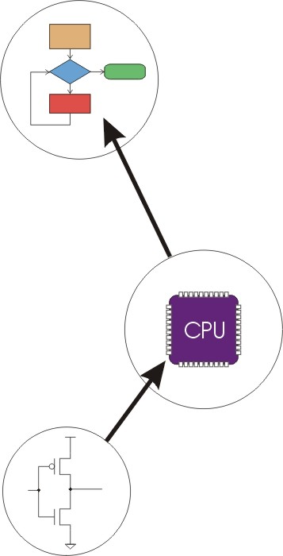
Great Idea #4: Software and Hardware Co-design
Application
Algorithm & Data Structure
Language
Software
指令集体系结构 (Machine Architecture, ISA)
Hardware
Microarchiture
Now, You are Here.
Logic and IC
Device
How do we get the electrons to do the work?
Notes:
14

Slide 15
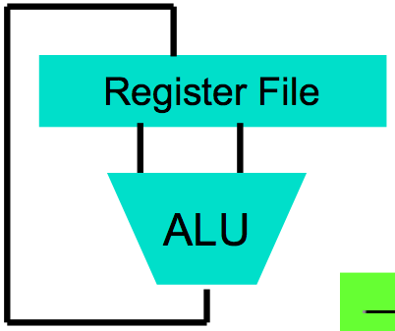
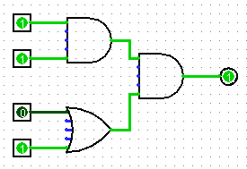
How do we get the electrons to do the work?
High Level Language
Program (e.g., C)
temp = v[k];
v[k] = v[k+1];
v[k+1] = temp;
Now, You are Here.
Compiler
lw $t0, 0($2)
lw $t1, 4($2)
sw $t1, 0($2)
sw $t0, 4($2)
Assembly Language Program (e.g., MIPS)
Anything can be represented
as a number,
i.e., data or instructions
Assembler
Machine Language Program (MIPS)
0000 1001 1100 0110 1010 1111 0101 1000
1010 1111 0101 1000 0000 1001 1100 0110
1100 0110 1010 1111 0101 1000 0000 1001
0101 1000 0000 1001 1100 0110 1010 1111
Machine Interpretation
Hardware Architecture Description
(e.g., block diagrams)
Architecture Implementation
ALUOP[0:3] <= InstReg[9:11] & MASK
Logic Circuit Description
(Circuit Schematic Diagrams)

Slide 16
Instruction Set Architecture (ISA)
Computer’s native operations called instructions.
Job of a CPU (Central Processing Unit): execute instructions
  Instructions: CPU’s primitives operations
  Instructions performed one after another in sequence
  Each instruction does a small amount of work (a tiny part of a larger program).
  Each instruction has an operation applied to operands, and might be used change the sequence of instruction.
Instruction set architecture (ISA) specifies the set of commands (instructions) a computer can execute
Hardware registers provide a few very fast variables for instructions to operate on

Slide 17
Instruction Set Architecture (ISA)
The instruction set defines all the valid instructions.
CPUs belong to “families,” each implementing its own set of instructions
CPU’s particular set of instructions implements an Instruction Set Architecture (ISA)
Examples:
  ARM,
  Intel x86
  MIPS
  RISC-V
  IBM/Motorola PowerPC (old Mac)
  Intel IA64,
  ...

Slide 18
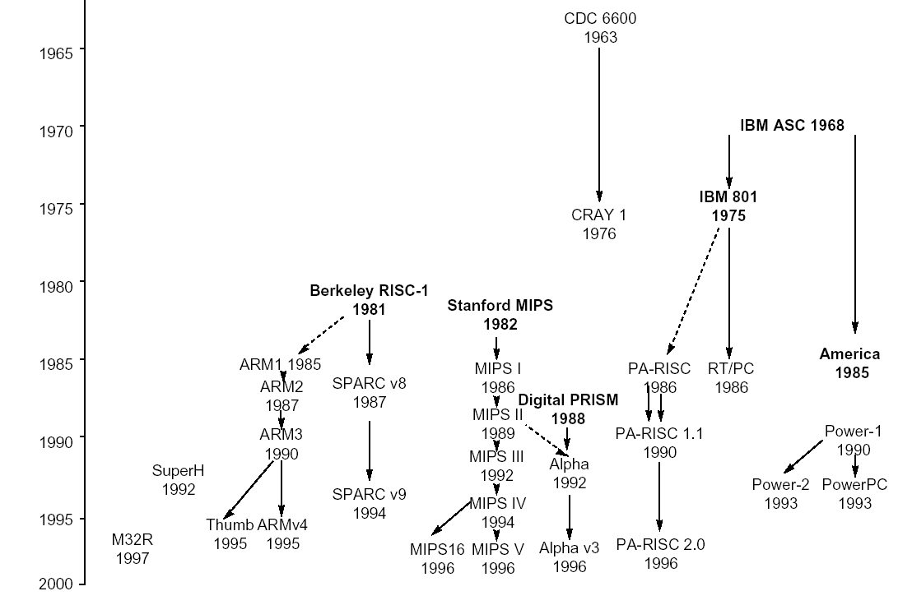
Instruction set architecture evolution

Slide 19
LC-3 ISA
_{运算指令(Operate Instructions)}
15
14
13
12
11
10
9
8
7
6
5
4
3
2
1
₀
数据移动指令
(Data Movement Instructions)
ADD
₀
₀
₀
1
DR
SR1
₀
₀
₀
SR2
ADD
₀
₀
₀
1
DR
SR1
1
_{Imm5}
取数指令(Load)
AND
₀
1
₀
1
DR
SR1
₀
₀
₀
SR2
AND
₀
1
₀
1
DR
SR1
1
Imm5
15
14
13
12
11
10
9
8
7
6
5
4
3
2
1
₀
LD
₀
₀
1
0
DR
_{PCoffset9}
NOT
1
₀
₀
1
DR
SR1
1
1
1
1
1
1
LDR
₀
₁
1
0
DR
BaseR
PCoffset6
Reserved
1
1
₀
1
LDI
₁
₀
1
0
DR
PCoffset9
控制指令(Control Instructions)
LEA
₁
₁
1
0
DR
PCoffset9
15
14
13
12
11
10
9
8
7
6
5
4
3
2
1
₀
存数指令(Store)
BR
₀
₀
0
0
n
z
_{p}
PCoffset9
JSR
₀
1
0
0
1
PCoffset11
15
14
13
12
11
10
9
8
7
6
5
4
3
2
1
₀
JSRR
₀
1
0
0
₀
₀
₀
BaseR
₀
₀
₀
₀
₀
₀
ST
₀
₀
1
1
SR
PCoffset9
RTI
1
₀
0
0
₀
₀
₀
₀
₀
₀
₀
₀
₀
₀
₀
₀
STR
₀
1
1
1
SR
_{BaseR}
PCoffset6
JMP
1
1
0
0
₀
₀
₀
BaseR
₀
₀
₀
₀
₀
₀
STI
1
₀
1
1
SR
PCoffset9
RET
1
1
0
0
₀
₀
₀
1
1
1
₀
₀
₀
₀
₀
₀
TRAP
1
1
1
1
₀
₀
₀
₀
TrapVector8

Slide 20
Instruction Processing（state transtion）
F
Fetch instruction from memory
D
Decode instruction
EA
Evaluate address
OP
Fetch operands from memory
EX
Execute operation
S
Store result
Notes:
20

Slide 21
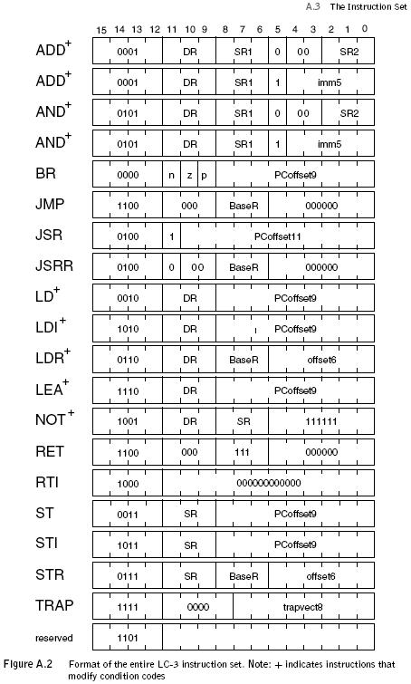
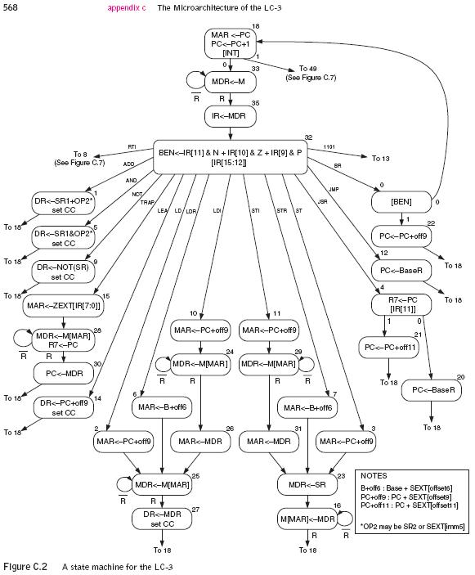
Instruction Set Architecture (ISA) vs. Finite State Automata

Slide 22
LC-3 Data Path
16
GatePC
16
GateMARMUX
LD.PC
PC
DR
3
MARMUX
+1
REG FILE
16
2
PCMUX
16
16
16
16
16
LD.REG
Control Unit
SR2
OUT
SR1
OUT
[7:0]
Processing Unit
SEXT
+
SR2
3
3
SR1
ADDR2MUX
MUX
MUX
ADDR1MUX
16
16
[10:0]
16
16
16
16
16
SEXT
[8:0]
LD.CC
16
SEXT
FINITE STATE MACHINE
SR2MUX
[5:0]
SEXT
16
N
Z
P
ALUK
A
B
[4:0]
SEXT
2
ALU
LD.IR
IR
LOGIC
…
16
16
16
RUN
GateALU
16
GateMDR
16
Memory Unit
LD.MDR
MDR
MEMORY
MAR
LD.MAR
16
INPUT
OUTPUT
MIO.EN
MUX
16
MEM.EN,R,W

Slide 23
LC-3 Data Path
16
TRAP
RTI
GatePC
16
GateMARMUX
LD.PC
PC
DR
3
MARMUX
+1
REG FILE
16
2
PCMUX
16
16
16
16
16
LD.REG
[7:0]
SR2
SR2
OUT
SR1
OUT
SR1
TRAP
SEXT
+
3
3
ADDR2MUX
MUX
MUX
ADDR1MUX
16
16
JSR
16
16
16
16
16
[10:0]
SEXT
[8:0]
LD.CC
16
SEXT
FINITE STATE MACHINE
SR2MUX
[5:0]
SEXT
16
Imm5
N
Z
P
ALUK
A
B
[4:0]
SEXT
2
ALU
LD.IR
IR
LOGIC
…
16
16
16
RUN
GateALU
16
GateMDR
16
LD.MDR
MDR
MEMORY
MAR
LD.MAR
16
INPUT
OUTPUT
MIO.EN
MUX
16
MEM.EN,R,W

Slide 24
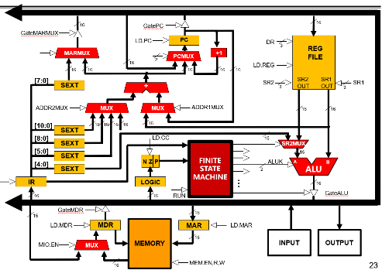
Data Path Components
Global bus
  special set of wires that carry a 16-bit signal to many components
  inputs to the bus are “tri-state devices,” that only place a signal on the bus when they are enabled
  only one (16-bit) signal should be enabled at any time
    control unit decides which signal “drives” the bus
  any number of components can read the bus
    register only captures bus data if it is write-enabled by the control unit
Memory
  Control and data registers for memory and I/O devices
  memory: MAR, MDR (also has control signal for read/write)
Notes:
24

Slide 25
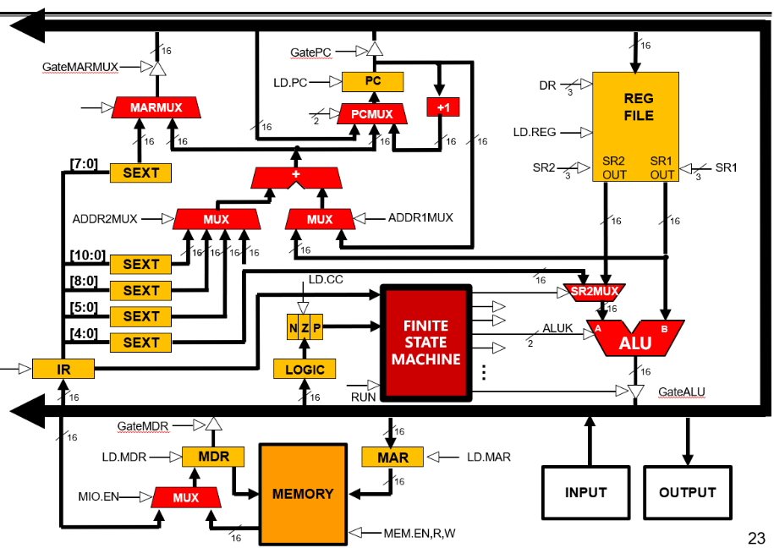
Data Path Components
ALU
  Accepts inputs from register file
  and from sign-extended bits from IR (immediate field).
  Output goes to bus.
    used by condition code logic, register file, memory
Register File
  Two read addresses (SR1, SR2), one write address (DR)
  Input from bus
    result of ALU operation or memory read
  Two 16-bit outputs
    used by ALU, PC (JMP), memory address(STR,LDR)
Notes:
25

Slide 26

Data Path Components
PC and PCMUX
  Three inputs to PC, controlled by PCMUX
    PC+1 – FETCH stage
    Address adder – BR, JMP
    bus – TRAP (discussed later)
MAR and MARMUX
  Two inputs to MAR, controlled by MARMUX
    Address adder – LD/ST, LDR/STR
    Zero-extended IR[7:0] -- TRAP (discussed later)
Notes:
26

Slide 27
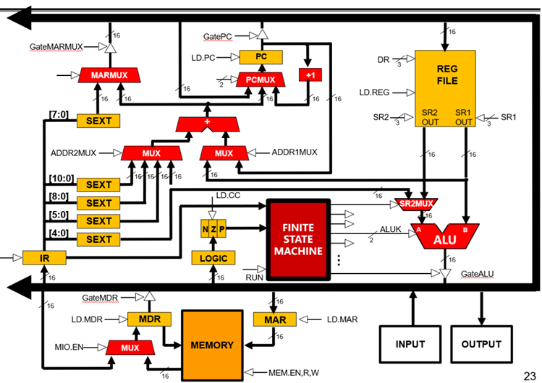
Data Path Components
Condition Code Logic
  Looks at value on bus and
  generates N, Z, P signals
  Registers set only when
  control unit enables them (LD.CC)
    only certain instructions set the codes
    (ADD, AND, NOT, LD, LDI, LDR, LEA)
Control Unit – Finite State Machine
  On each machine cycle, changes control signals for next phase
  of instruction processing
    who drives the bus? (GatePC, GateALU, …)
    which registers are write enabled? (LD.IR, LD.REG, …)
    which operation should ALU perform? (ALUK)
    …
  Logic includes decoder for opcode, etc.
Notes:
27

Slide 28
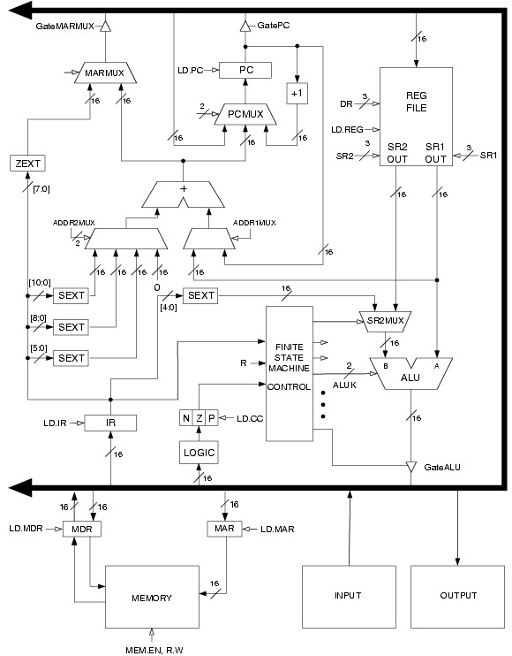
LC-3 Data Path
Filled arrow
= info to be processed.
Unfilled arrow
= control signal.

Slide 29
LC-3 Data Path
Control Unit
Processing
Unit
Filled arrow
= info to be processed.
Unfilled arrow
= control signal.
Memory
2025/10/19
29

Slide 30
Outline
1
1
Review
Review
2
An Example: Counting Occurrences of a Character
2
From ENIAC to the Stored Program Computer
3
3
A Machine Structure：von Neumann Model
ISA & Data Path Revisited
4
4
Summary
Summary

Slide 31
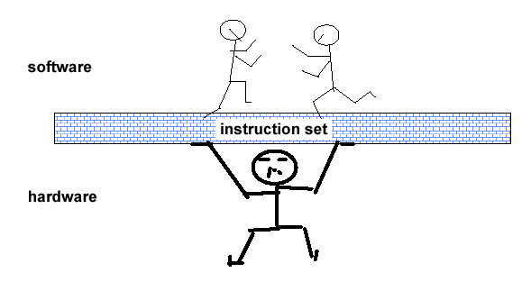
Definition of computer architecture: classical definition
... the attributes of a [computing] system as seen by the programmer, i.e. the conceptual structure and functional behavior, as distinct from the organization of the data flows and controls the logic design, and the physical implementation. – Amdahl, Blaaw, and Brooks, 1964

Slide 32
Instruction Set Architecture: What does each cycle do?
Stage1:从存储系统中获得指令
Instruction
Fetch
Stage2:确定做何动作
Instruction
Decode
Stage3:获得操作数
Operand
Fetch
Stage4:产生运算结果或状态
Execute
Stage5:向存储系统中存放运算结果
Result
Store
Stage6:确定下一条要执行的指令
Next
Instruction

Slide 33
Roadmap To Future Classes...
Compilers
  All the processes in going from source code to assembly
OS
  OS often needs a small amount of assembly for doing things the "high level“ language doesn't support
    Such as accessing special resources
Computer Architecture
  How to build the computer that supports the assembly
Computer Security
  Exploit code ("shell code") is often in assembly and exploitation often requires understanding the assembly language of the target.

